Slide 1
NEED BLOOD Naveen Kumar (19103071) Rohan Bansal (19103095) Rohit Jawa (19103096) Mentor: Prof. H.K Verma
A Step Towards Helping

Slide 2
Problems Faced By Common People
01
03
02
04
Urgent Need
Donor Unavailability
In case of emergencies there may be an urgent need of blood or platlets.
It becomes very difficult to find a donor immediately with the required blood.
Blood Bank policy
Rare Blood Groups
Most of the blood banks asks to donate blood first to receive blood units.
Several blood groups are very rare to find in blood banks.

Slide 3
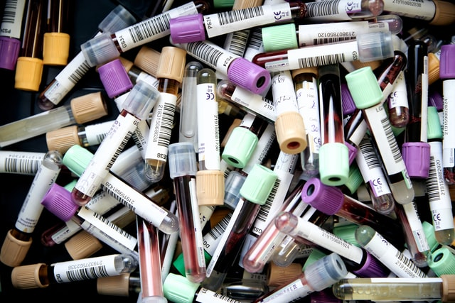
Solution
The solution to this problem is to create a vast centralized system of donors. This will entertain any blood request as soon as possible.

Slide 4
Overview Of The Application
This application can be used to check availability status of blood. The user can provide the required city and blood group to find out the list of eligible donors.
Donor Login
Donor Search
Ask Queries

Slide 5
Description
1
The web application comes with a clean, simple and easy to use UI specially for people who are not much tech savvy.
2
New users can register themselves by providing their basic information.
3
People can search for donors by entering city details and blood group.
4
Donors can also update their profile information like contact and availability.
5
Anyone can ask a query about blood donation which shall be acknowledged and answered.

Slide 6
Structure Of The Application
The home page has 3 sections. One is Need Blood which redirects to search page. Second is Login which takes you to the Login/Register page. Last one is AskQueries to ask any question.
Two data schemas have been used in the project. One is the donor information and the other one is query submissions.
The registration page includes information about the donor like blood type, phone number, city, age, etc.
The searching page prompts you to search donor by the entering the city and blood group of the required donor.
The donor can also update/correct his information like availability, phone number, etc.

Slide 7
Tech Stacks Used In Our Application
Language- HTML, CSS, Javascript
Libraries & Frameworks – Bootstrap, Express.js, Node.js, EJS, Passport.js, MongoDB
Version Control - Git & GitHub
Code Editor & Environment - VS Code, Sublime & Robo3T

Slide 8
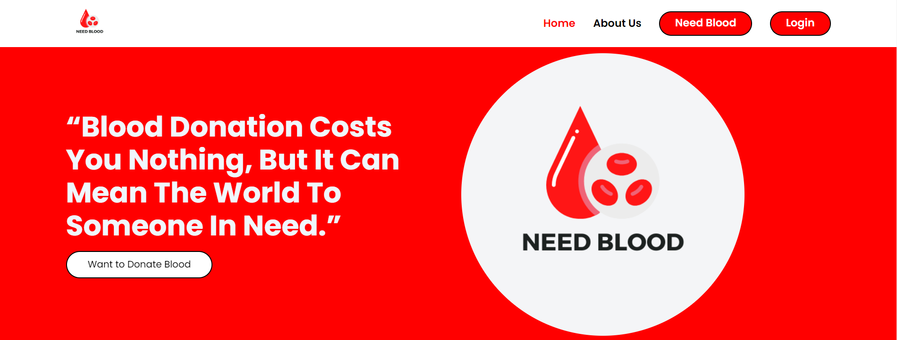
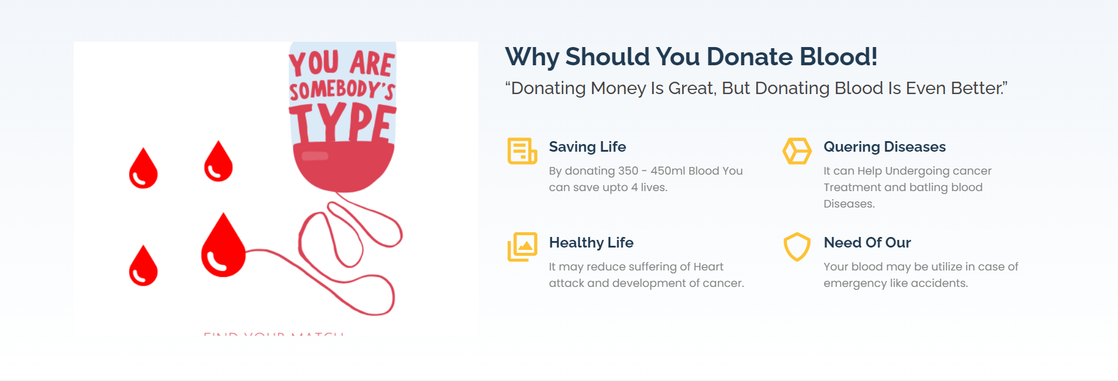
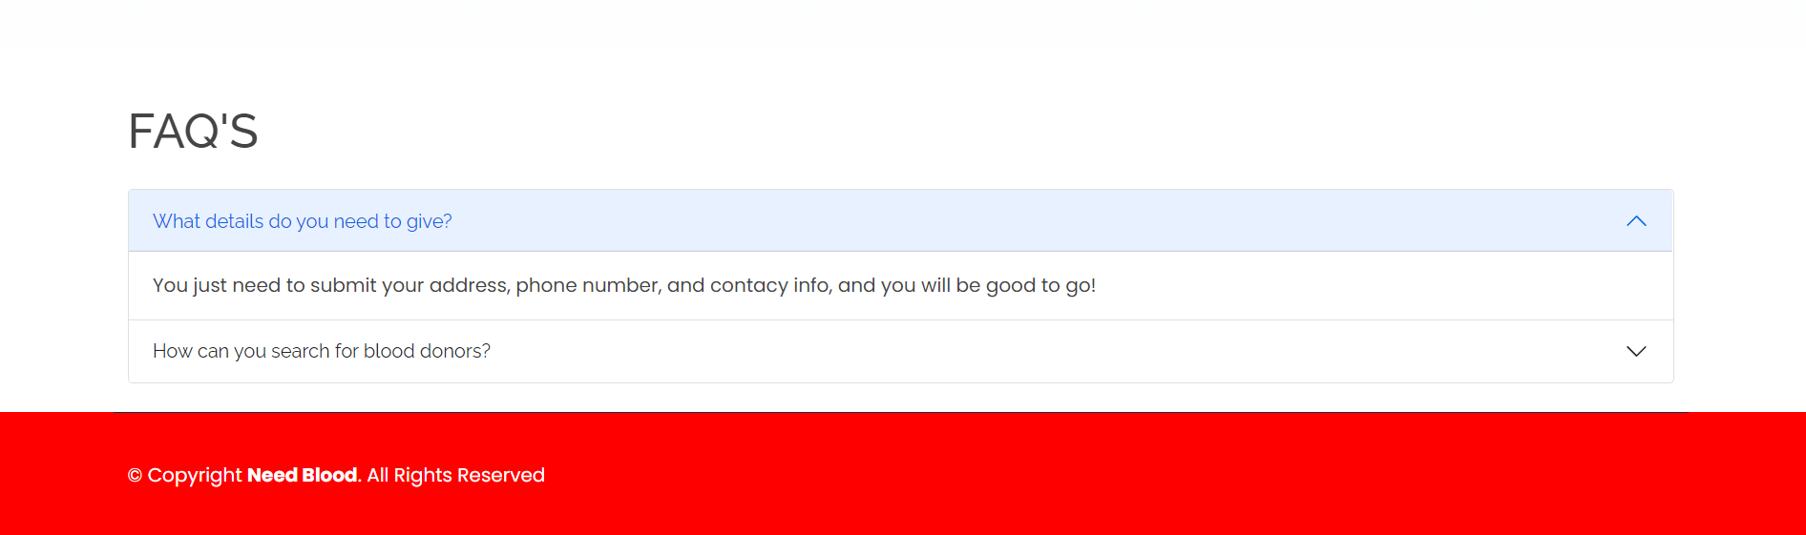
UI Of Main Page

Slide 9
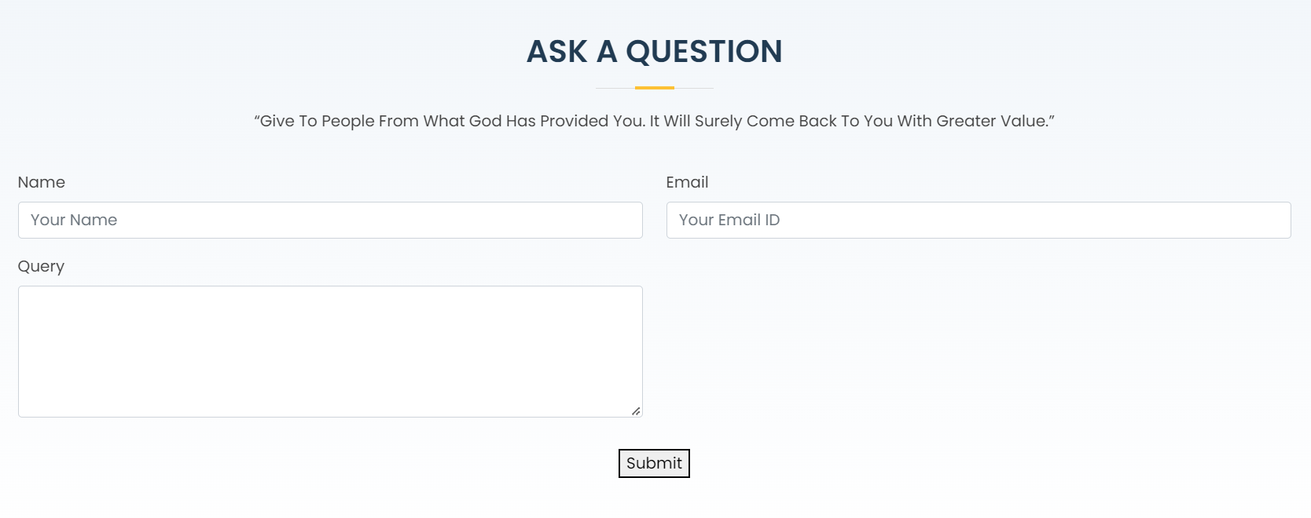
Ask Query

Slide 10
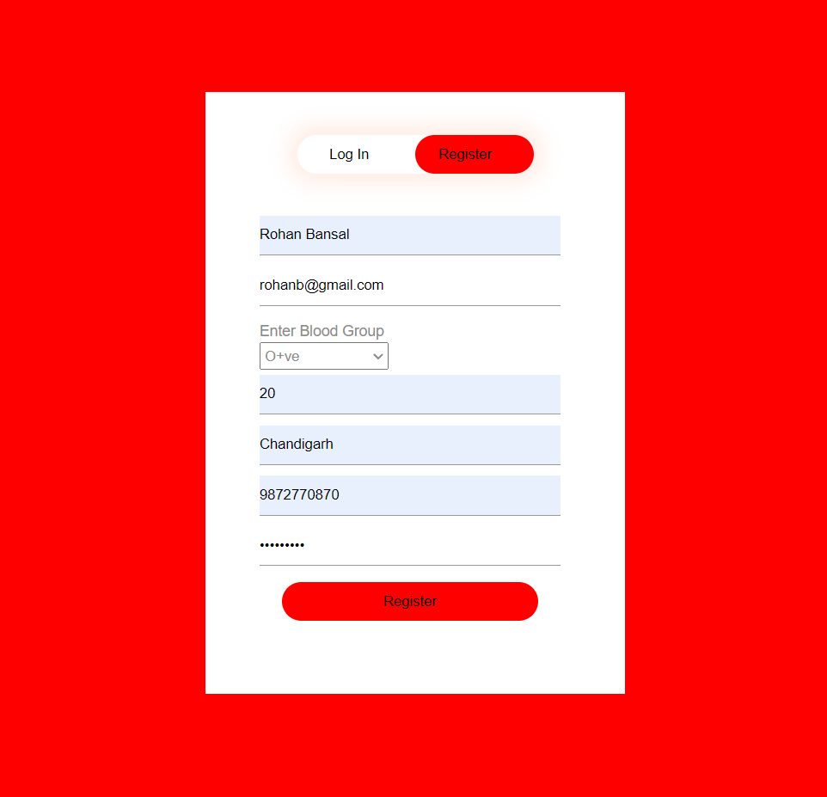
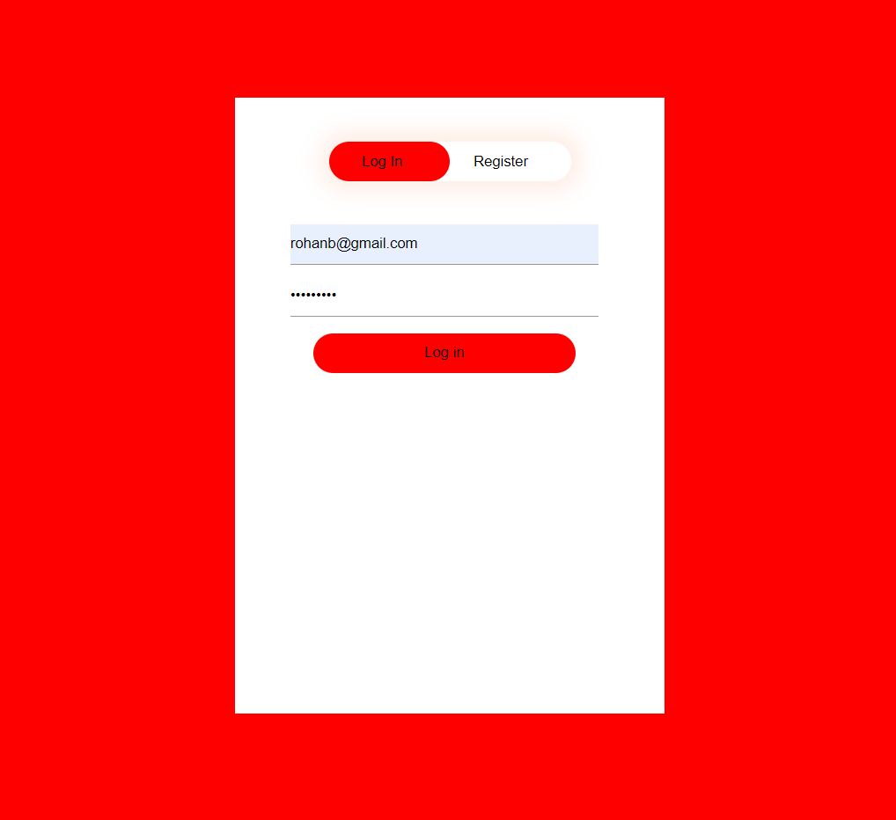
Login and Register

Slide 11
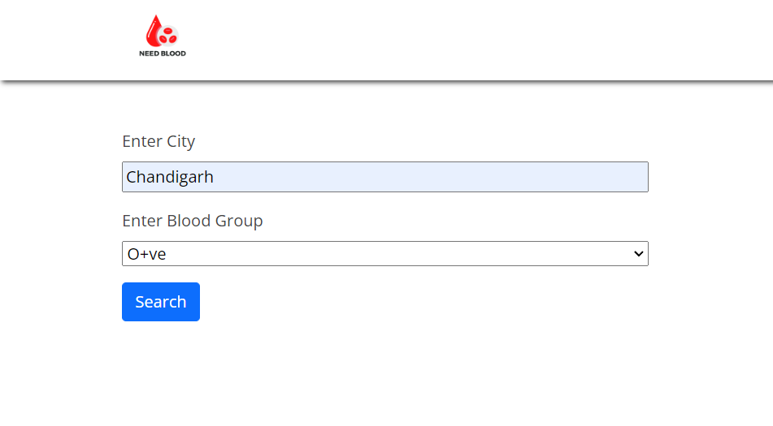
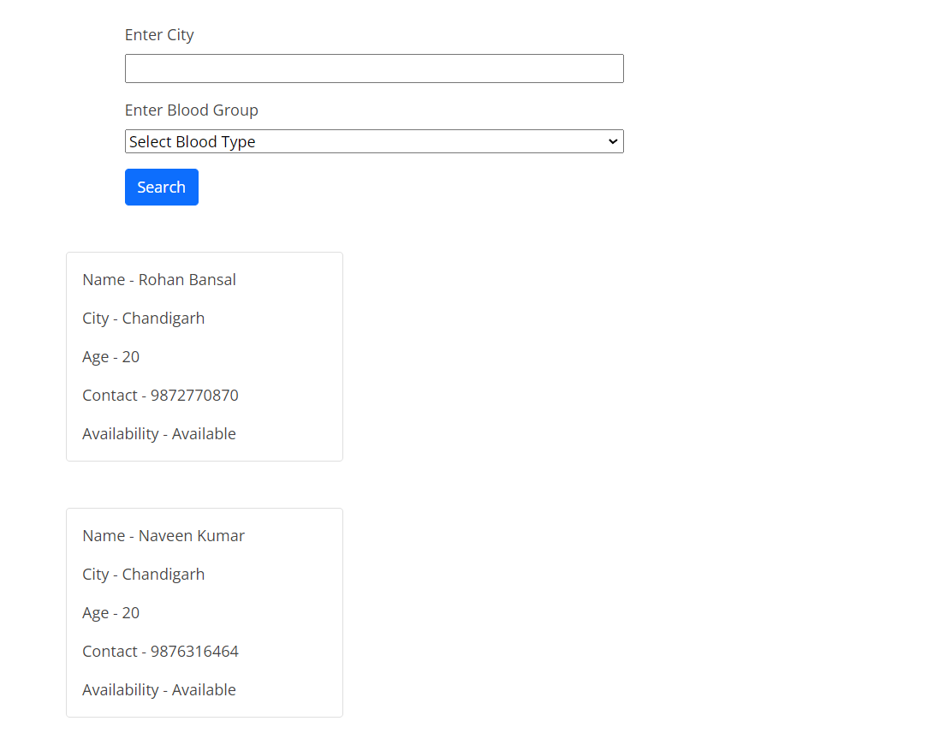
Search Page

Slide 12
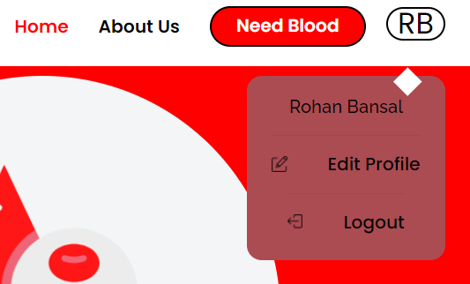
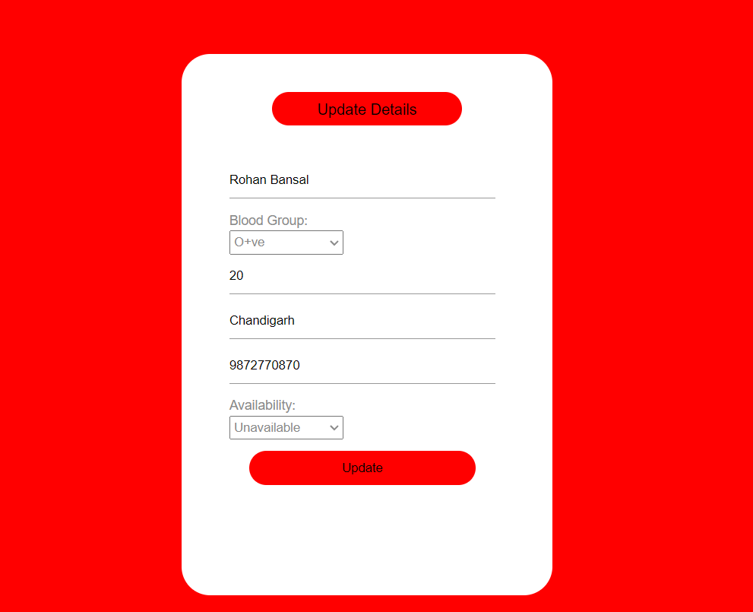
Update Page
Changed Availability

Slide 13
Future Scope and Changes
01
02
03
04
Some more sections can be added for improvement of our application which includes the following -
ChatBot for Query Addressing
Signup using Google
Alerting Donors when a request is posted
Request Tracking

Slide 14
Thank You

